Slide 1
Directed Acyclic Graphs
A directed acyclic graph or DAG is a directed graph with no directed cycles:
David Luebke <number> 11/07/26

Slide 2
DFS and DAGs
Argue that a directed graph G is acyclic iff a DFS of G yields no back edges:
  Forward: if G is acyclic, will be no back edges
    Trivial: a back edge implies a cycle
  Backward: if no back edges, G is acyclic
    Argue contrapositive: G has a cycle ⇒ ∃ a back edge
      Let v be the vertex on the cycle first discovered, and u be the predecessor of v on the cycle
      When v discovered, whole cycle is white
      Must visit everything reachable from v before returning from DFS-Visit()
      So path from u→v is yellow→yellow, thus (u, v) is a back edge
David Luebke <number> 11/07/26

Slide 3
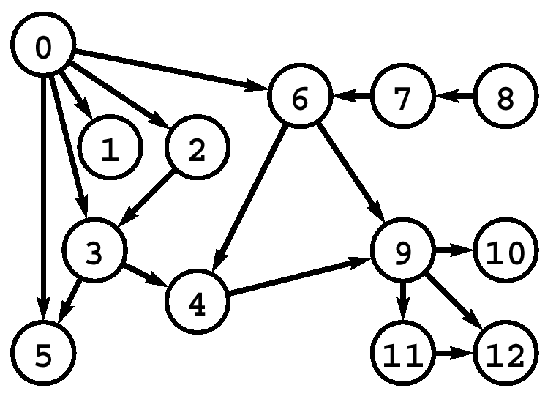
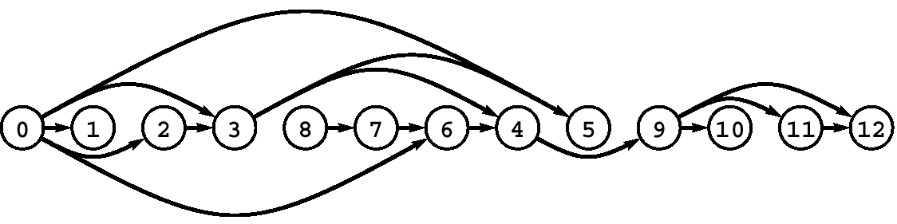
Topological Sort
DAG. Directed acyclic graph.
Topological sort. Redraw DAG so all edges point left to right.
Observation. Not possible if graph has a directed cycle.

Slide 4
Application: Scheduling
Scheduling. Given a set of tasks to be completed with precedence constraints, in what order should we schedule the tasks?
Graph model.
  Create a vertex v for each task.
  Create an edge v→w if task v must precede task w.
  Schedule tasks in topological order.
0. read programming assignment
1. download files
2. write code
…
12. sleep
Notes:
course v_{i} must be taken before v_{j}.
Compilation: module v_{i} must be compiled before v_{j}
Pipeline of computing jobs: output of job v_{i} needed to determine input of job v_{j}.

Slide 5
Topological Sort
Topological sort of a DAG:
  Linear ordering of all vertices in graph G such that vertex u comes before vertex v if edge (u, v) ∈ G
Real-world example: getting dressed
David Luebke <number> 11/07/26

Slide 6
Getting Dressed
Underwear
Socks
Watch
Pants
Shoes
Shirt
Belt
Tie
Jacket
David Luebke <number> 11/07/26

Slide 7
Getting Dressed
Underwear
Socks
Watch
Pants
Shoes
Shirt
Belt
Tie
Jacket
Socks
Underwear
Pants
Shoes
Watch
Shirt
Belt
Tie
Jacket
David Luebke <number> 11/07/26

Slide 8
Topological Sort Algorithm
Topological-Sort()
{
  Run DFS
  When a vertex is finished, output it
  Vertices are output in reverse topological order
}
Time: O(V+E)
Correctness: Want to prove that
(u,v) ∈ G ⇒ u→f > v→f
David Luebke <number> 11/07/26

Slide 9
Correctness of Topological Sort
Claim: (u,v) ∈ G ⇒ u→f > v→f
  When (u,v) is explored, u is yellow
    v = yellow ⇒ (u,v) is back edge. Contradiction (Why?)
    v = white ⇒ v becomes descendent of u ⇒ v→f < u→f
    (since must finish v before backtracking and finishing u)
    v = black ⇒ v already finished ⇒ v→f < u→f
David Luebke <number> 11/07/26

